Slide 1

Mukbang and Social Connection: Cultural & Developmental Perspectives in Young Adulthood
Angela L. Nadeau, Senior Instructor
October 24, 2025

Slide 2
Food for Thought – Sharing Meals and Connection
When was the last time you shared a meal with someone?
Have you ever talked about your meals with others?
What is about eating together that connects us?
What if you didn’t share meals with others, what might it be like?
Eating is more than nourishment—it’s a social act that connects us.

Slide 3
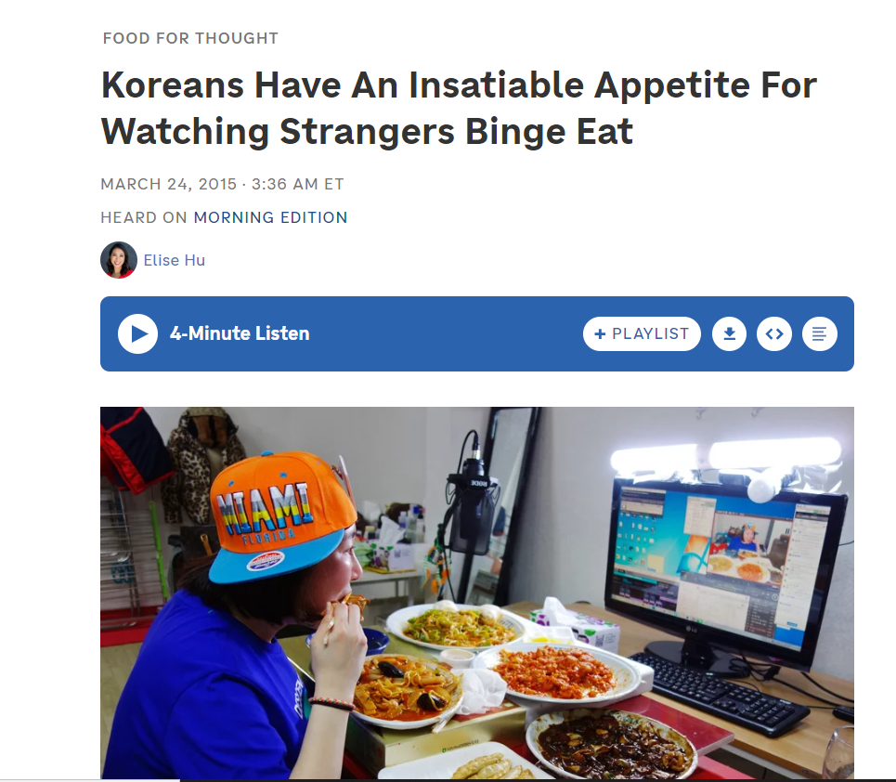


먹방 meokbang
Korean words for “eating” 먹는 meongneun) and “broadcast” 방송 bangsong.
Originated in South Korea around 2009 and 2010 (before COVID)
Global popularity: Park Seo-yeon (The Diva) earns $9,000/month
Continued worldwide popularity; ASMR

Slide 4
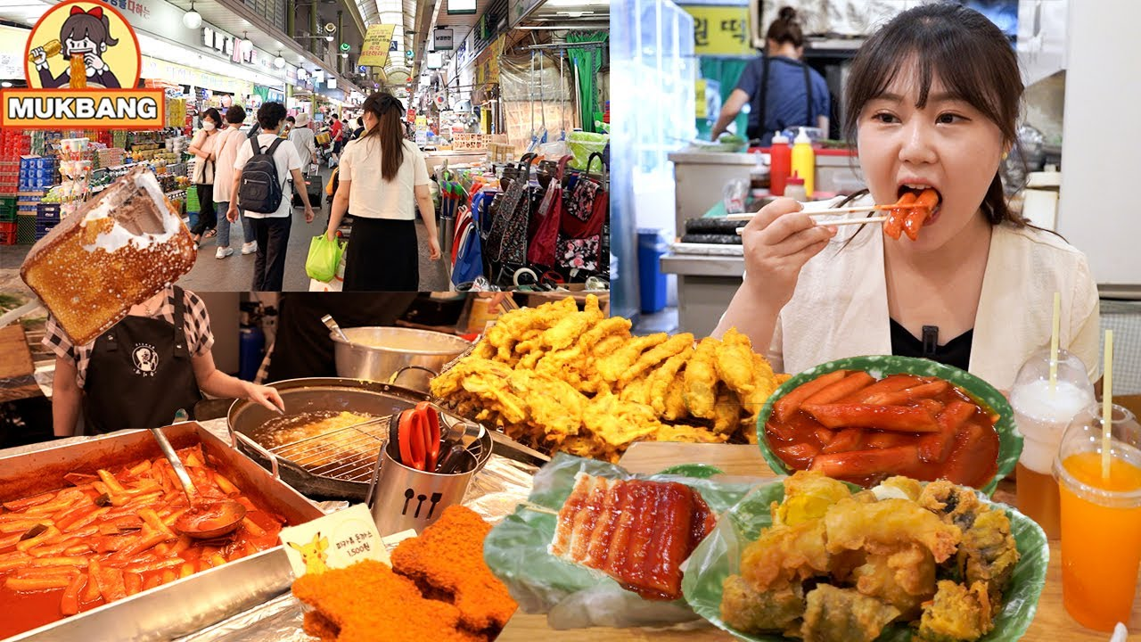
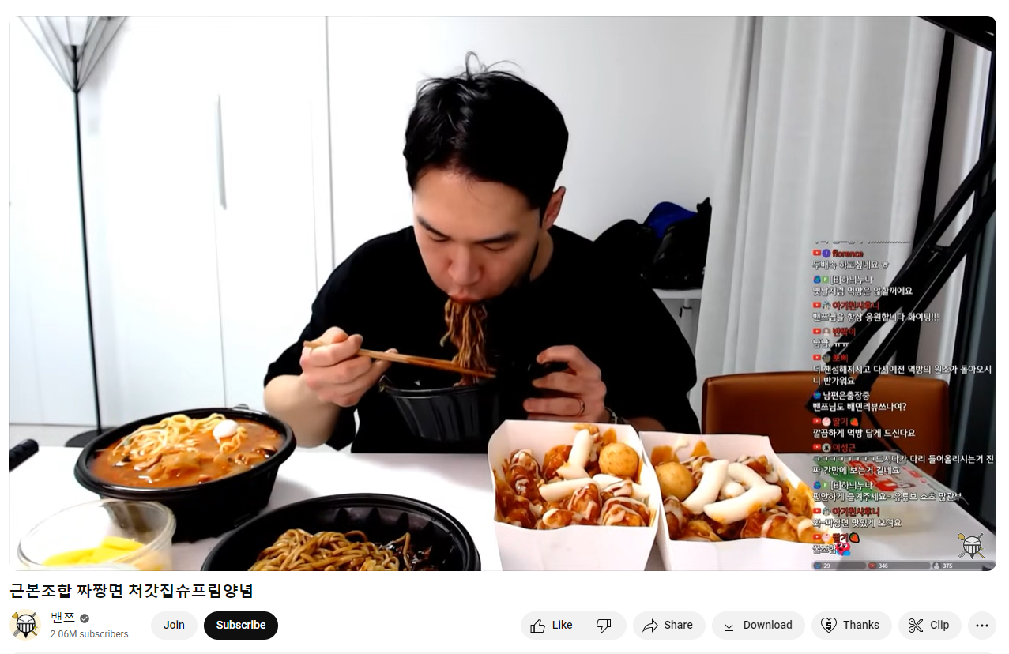
How does Mukbang work?
Mukbanger eat on a live streaming, chat-based platform
  Most mukbangers speak in a calm, engaging voice
  Talk about current life and food experience
  New trends of storytelling (crime stories) during mukbang
  Different interactions for different mukbang purposes
Excessive, binge-eating generally on unhealthy foods (noodles, pizza, take-away, fast-food, fried foods, “weird” foods)
Some viewers are eating simultaneously with mukbang; interacting
Mukbang videos can last 15 minutes or more; some are an hour or more
Sensitive microphones, & good lighting
  sound to enhance sensory experience (ASMR)

Slide 5
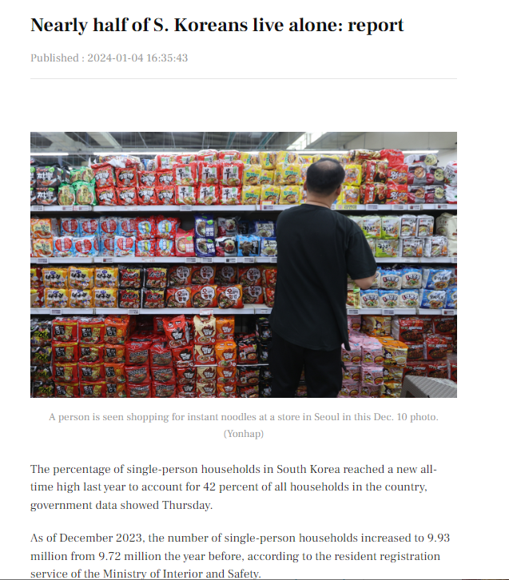
Why did Mukbang Emerge?
Single-person households: 42% (2023), up from 34% in 2022
20% of single-person residences are single adults, work long hours with limited time for prepping, cooking and eating
Long work hours → less time for cooking & socializing
Increased loneliness and social isolation
Missing the experience of eating together
Mukbang fills the gap of commensality—the act of eating together

Slide 6
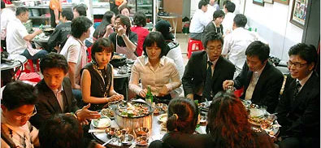
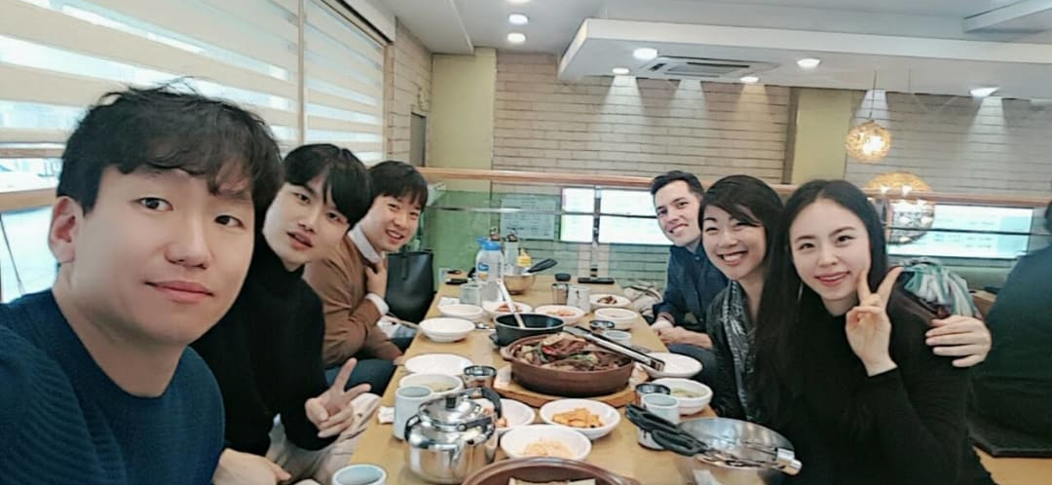
Commensality in
Korean Culture
Shared small plates (banchan) and group meals
Family bonding and conversation centered around food
Eating together = belonging
Talking about food/discussing food common social interaction
Eating together is both cultural and developmental.

Slide 7
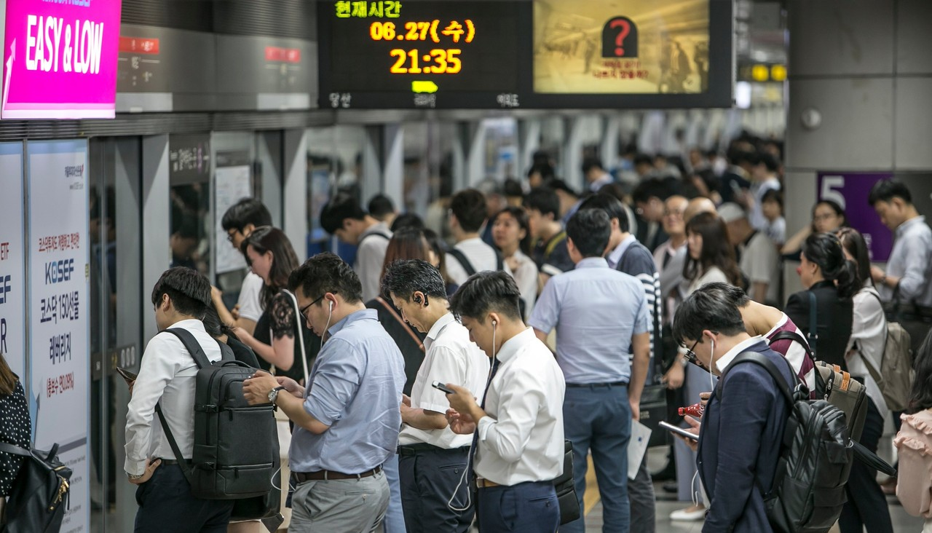

Cultural and Work Norms in Young Adulthood
High social expectations: Academic excellence, career success, and constant performance pressure.
Competition culture: “Spec” culture (specifications of success) — résumés packed with degrees, internships, language scores.
Confucian collectivism: Harmony & respect for hierarchy can increase stigma around mental health.
Shame and stigma: Failure or unemployment often internalized; seeking help seen as weakness.
Work expectations: Overtime, “hurry-hurry” culture, Nunchi, Kibun (maintaining emotional harmony), etc.
Result: Elevated stress, loneliness, and depression among youth; emotional burnout despite digital connectivity.

Slide 8
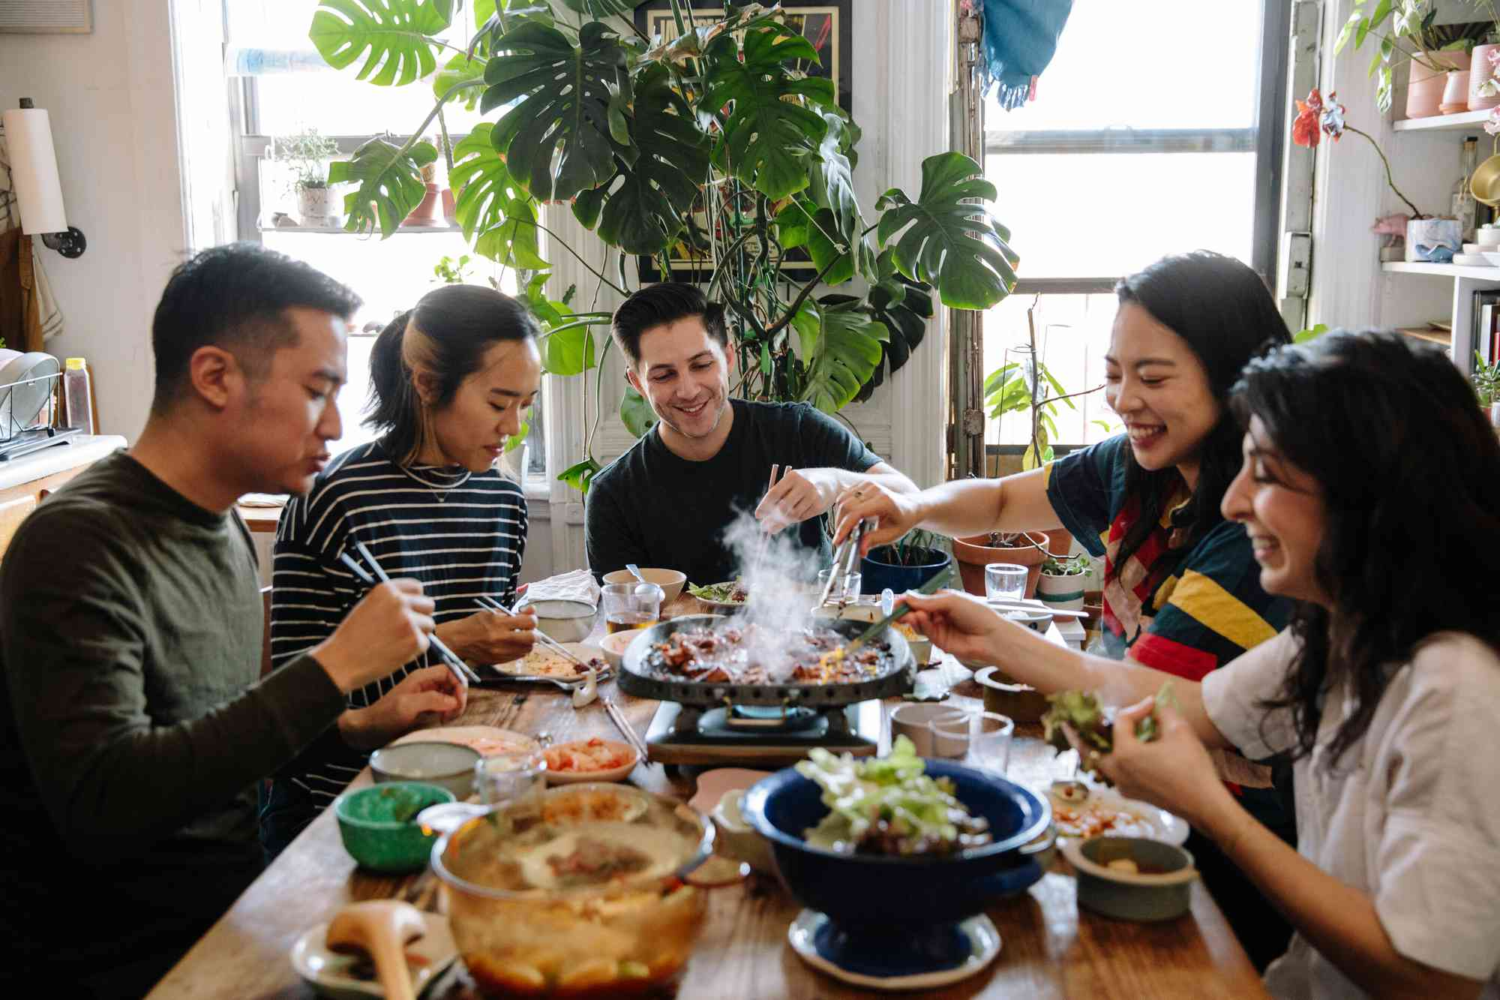
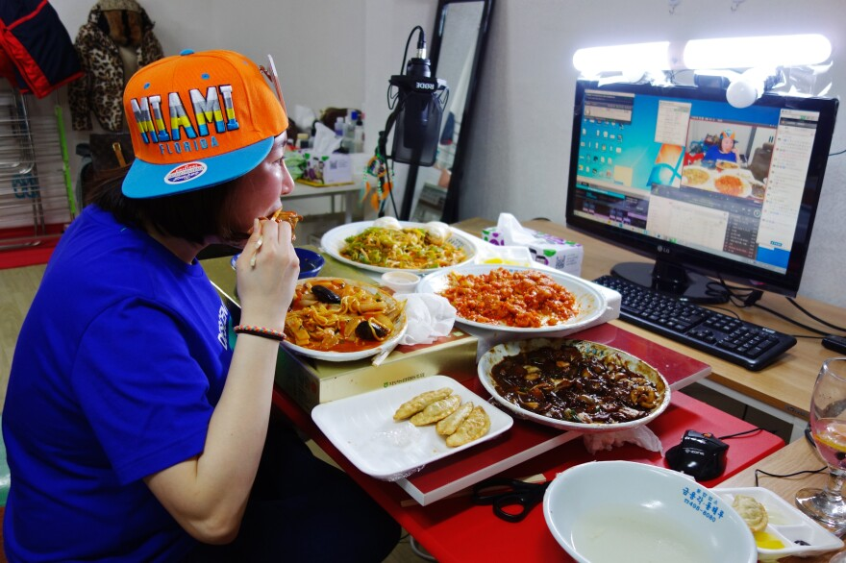
Erikson’s Theory – Intimacy vs. Isolation
• Developmental stage: early adulthood (20–40 years)
• Developmental Task: build deep, trusting relationships without losing self
• Success → intimacy and connection
• Failure → loneliness and isolation
Mukbang reflects a struggle for intimacy in a hyperconnected world.
https://www.simplyrecipes.com/korean-bbq-at-home-7483421

Slide 9
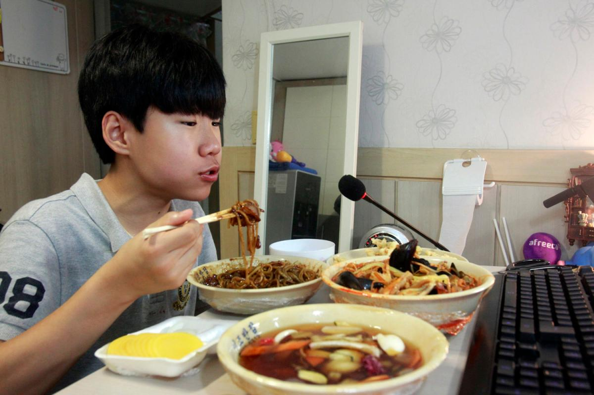
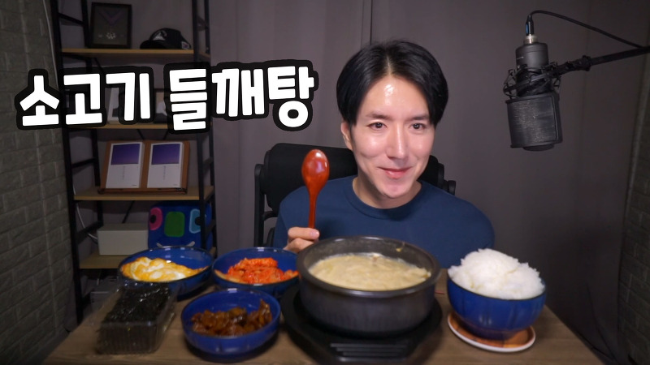
Psychological Reasons for Watching Mukbang
• Social facilitation: fosters emotional connections with others and reduces loneliness, simulates companionship
• Escapism: escape from stress, guilt, or fast-paced life
• Vicarious satisfaction: eat “through” others
• Parasocial connection: emotional attachment to the streamer
Co-presence without co-location.
• Sexualization of mukbangers (ASMR and fetishes)
Kircaburun, K., Harris, A., Calado, F., Griffiths, M. (2021)
This Photo by Unknown Author is licensed under CC BY

Slide 10
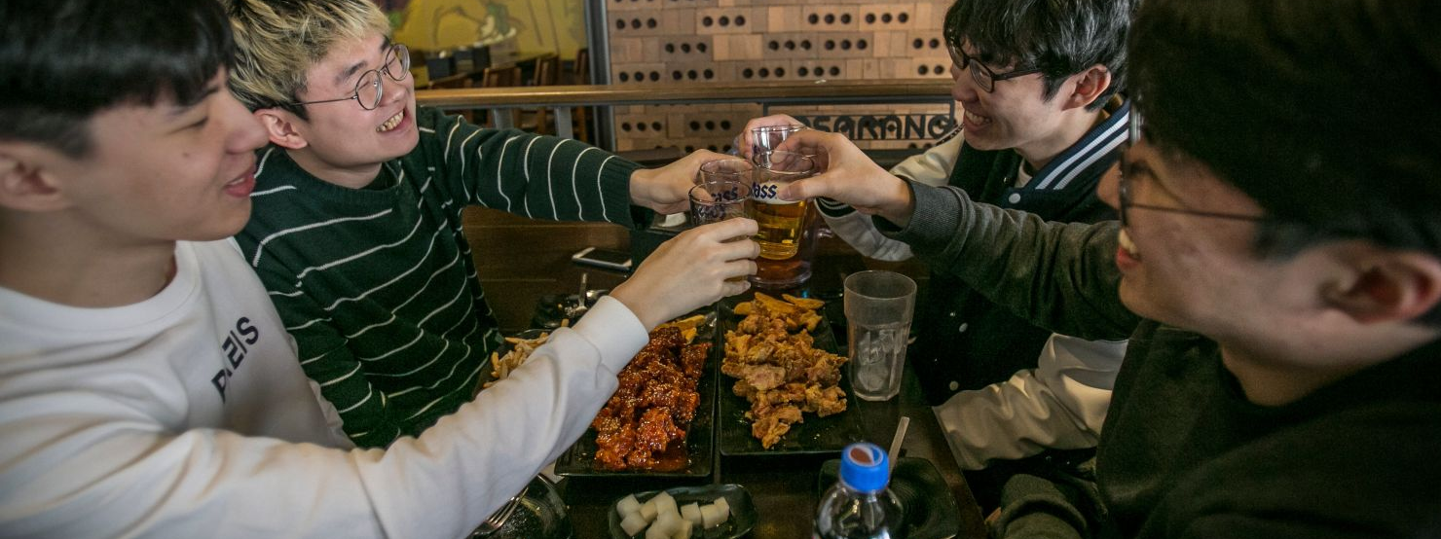
The Double-Edged Sword of Mukbang
Substituting watching mukbang for actual socialization and increase in social isolation
Comforting, but can’t substitute for real connection
Watching others eat ≠ sharing a meal
Reinforces passive social interaction and isolation
Digital connection isn’t the same as human connection

Slide 11

Social Isolation in South Korea
5% (≈540,000) young adults in extreme social isolation (2023)
When isolation defined as 1+ month → 26% report seclusion periods
Emotional consequences: hopelessness, anxiety, depression
Online-only interaction common
Related cultural syndromes:
Hikikomori (Japan) – more about social anxiety
Tang ping (China) – more about giving up
Factors → ESW
Work and Societal Pressures
High pressure jobs, academic pressures, job searching, job loss, long working hours, hyper competition
Family or social problems
Bullying, family conflict, lack of care from parents, parental expectations

Slide 12

Social Isolation in Young Adulthood & Possible Correlations in Society
“Sampo generation”: giving up dating, marriage, and children. Social isolation lowers fertility rates further
Fertility rate <1%; one of the world’s lowest.
Future smaller workforce due to population trends
Suicide rate: 28.6 per 100,000 (among highest globally)
Economic costs of youth isolation: >$5.6 billion

Slide 13
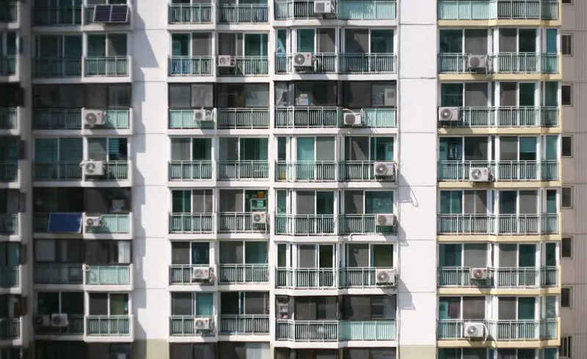
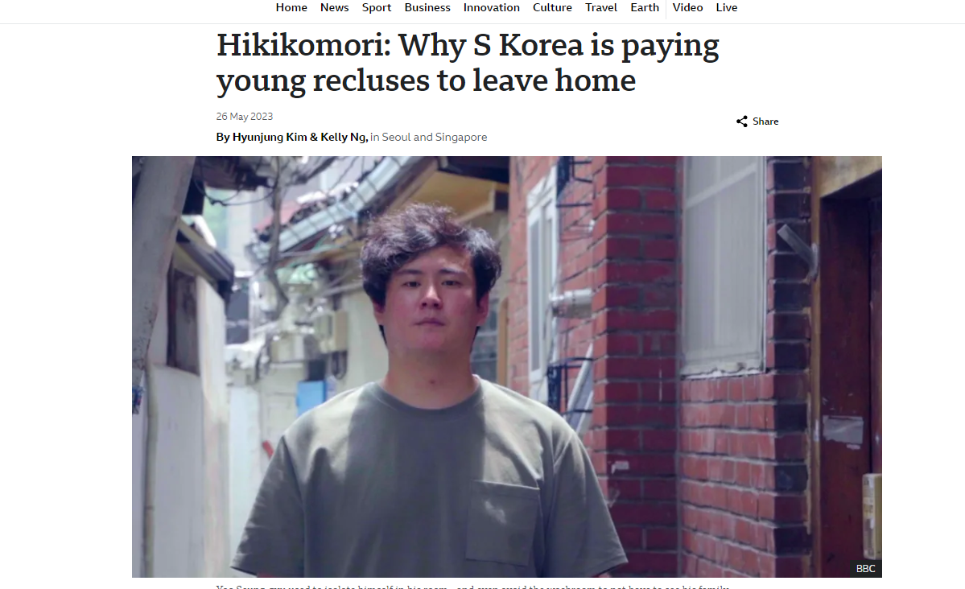
SK Government and Local Response as of 2023
2023: 5.9% of 15–29-year-olds were unemployed
NEET Lifers: A program where participants participate in daily check-ins, goal-setting, relational activities, develop routines and lasts 3-4 months
Neet Office: An offline community where work in groups on projects supported by foundations and investors
Monthly stiped to reclusive youths of $500-665 to re-engage in society
“Enable reclusive youth to recover their daily lives and reintegrate into society.” – Ministry of Gender Equality (2023)

Slide 14

Beyond Korea – A Reflection on Social Isolation in a Digital Age
What do you think of addressing the issue of social isolation as a societal problem?
Is there a similar seclusion problem in the United States?
What are the benefits of programs to address social isolation?
What might genuine connection look like in the digital age for those in emerging adulthood?
This Photo by Unknown Author is licensed under CC BY

Slide 15
References
Gong, S.E. (2024, Feb. 11). Social isolation takes a toll on a rising number of South Korea’s young adults. National Public Radio. https://www.npr.org/2024/02/11/1229437757/social-isolation-south-korea#:~:text=A%202022%20survey%20by%20the,to%208.6%25%20of%20their%20peers.
Hakimey, H. & Yazdanifard, R. (2015). The review of mukbang (broadcast eating) phenomena and its relations within South Korean culture and society. Interational Journal of Management, Accounting and Economics 2(5), 443-445.
Hu, E. (15 March, 2015) [Audio podcast episode]. Koreans have an insatiable appetite for watching strangers binge eat. Morning Edition. https://www.npr.org/sections/thesalt/2015/03/24/392430233/koreans-have-an-insatiable-appetite-for-watching-strangers-binge-eat
Jun, J., (2023, May 16). Study reveals around half a million young Koreans live in isolation. The Korean Times. https://www.koreatimes.co.kr/www/nation/2024/04/113_350953.html
Kim, H. & Ng, Kelly (26 March, 2023). Hikikimori: Why S Korea is paying young recluses to leave home. BBC. https://www.bbc.com/news/world-asia-65554271
Kircaburun, K., Harris, A., Calado, F., Griffiths, M. (2021). The psychology of mukbang watching: A scoping review of the academic and non-academic literature. International Journal of Mental Health and Addition, 19, 1190-1213. https://doi.org/10.1007/s11469-019-00211-0
Shin, H., Jeongwan, P., Kim, H. (2024, March 26). Drawing young people out of social isolation in South Korea: Why vast numbers of young Koreans are experiences extreme social withdrawal and how to help them re-engage with society. Standford Social Innovation Review. Stanford University. https://ssir.org/articles/entry/solutions-social-isolation-south-korea
Lee, S. B., Shin, Y., Jeon, Y., & Kim, S. (2022). Factors affecting social isolation among the young adults in South Korea: A cross-sectional analysis. Frontiers in public health, 10, 979136.
TRT World. (2024, Jan. 22). South Korea encouraging reclusive youth to socialise. [Video]. YouTube. https://www.youtube.com/watch?v=hNwZmr0mWwA&t=5s

Slide 16
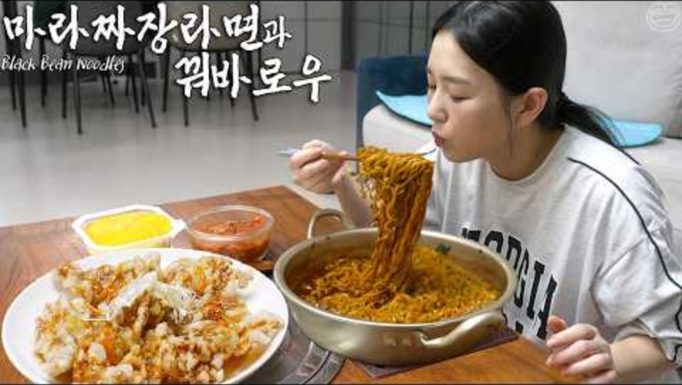
https://www.youtube.com/watch?v=rSSqGIPkOmA

